Slide 1
Environmental Causes of Conflict and Personal Social Responsibility
Dr. Babak RezaeeDaryakenari| The Hague

Slide 2


Slide 3
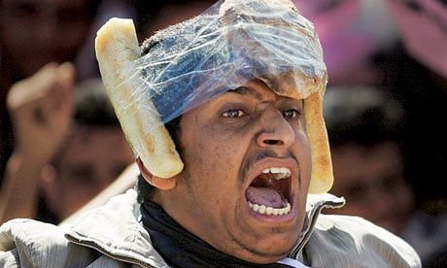
The famous “bread helmet” from Tahrir Square, Cairo, Egypt. Source: Reuters

Slide 4
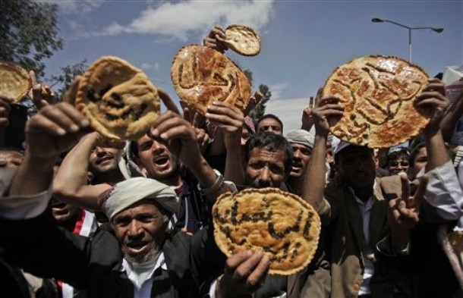
Anti-government protest in Sanaa, Yemen.
Source: AP

Slide 5
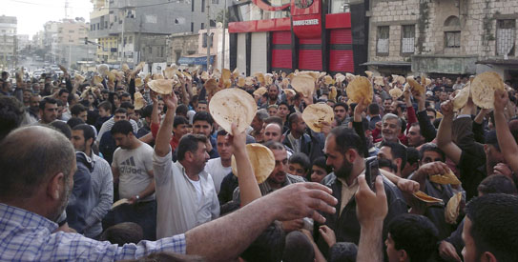
Anti-government protest in Syria.
Source: AP

Slide 6
What caused the Arab Spring?
Ethnic and/or religious tension
Dictatorship
The environmental issues
Economic issues
Corruption
Injustice

Slide 7
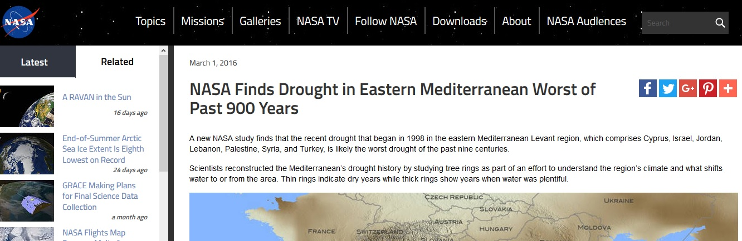
Drought in the middle east

Slide 8
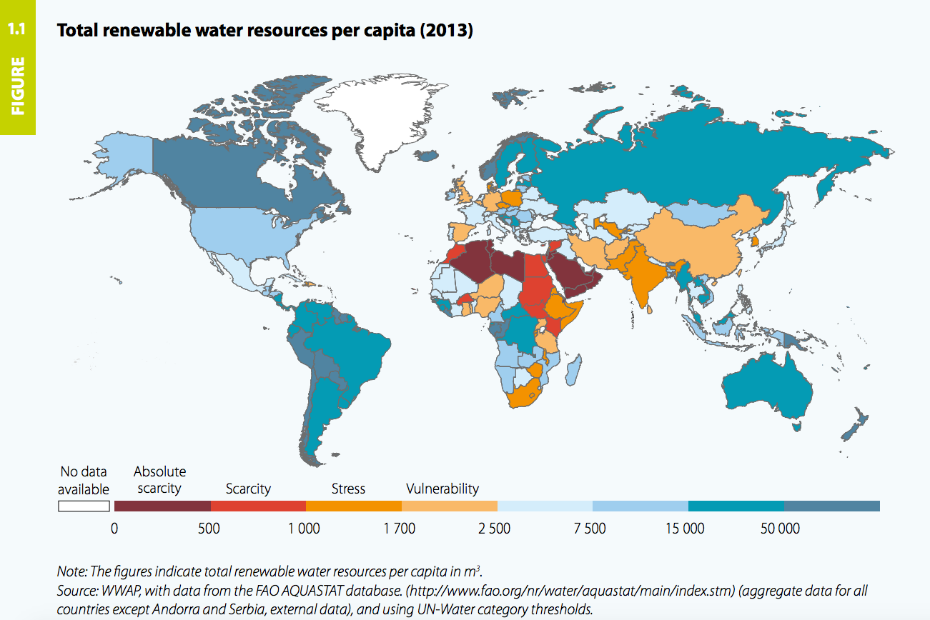
The water scarcity map of the world

Slide 9
Environmental causes of conflict?
“Climate wars” (Dyer 2008; Welzer 2012)
Climate change is “the mother of all risks” (TIME 2015)
“Climate change is making our world more violent and less secure” (Levy2014)
Political conflict scholars:
There is not a direct and general climate conflict link (Buhaug et al. 2014;Salehyan 2014)

Slide 10
The new wave of climate-conflict studies

Slide 11

Why does climate-caused conflict matter to us?

Slide 12
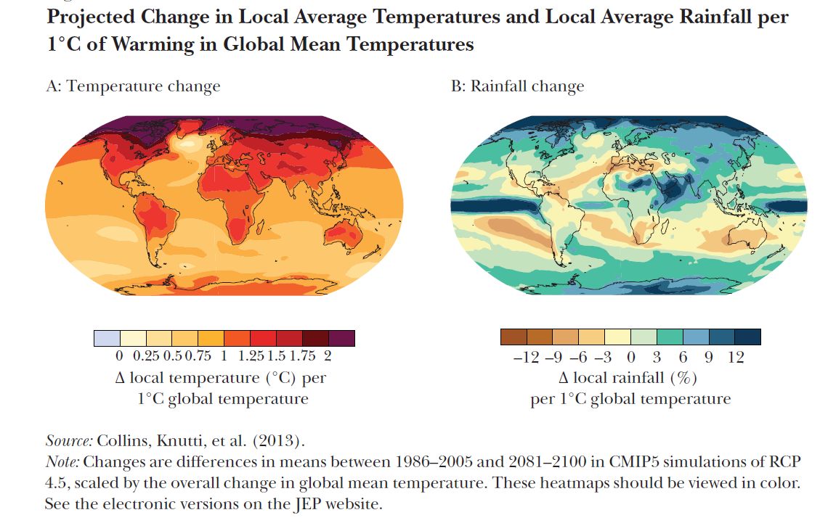
It is coming for us…

Slide 13
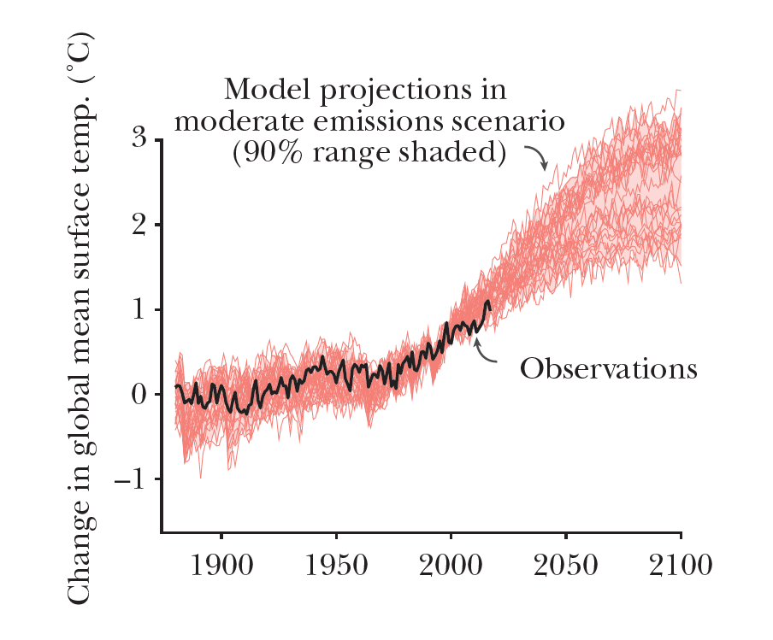
It is coming for us…

Slide 14
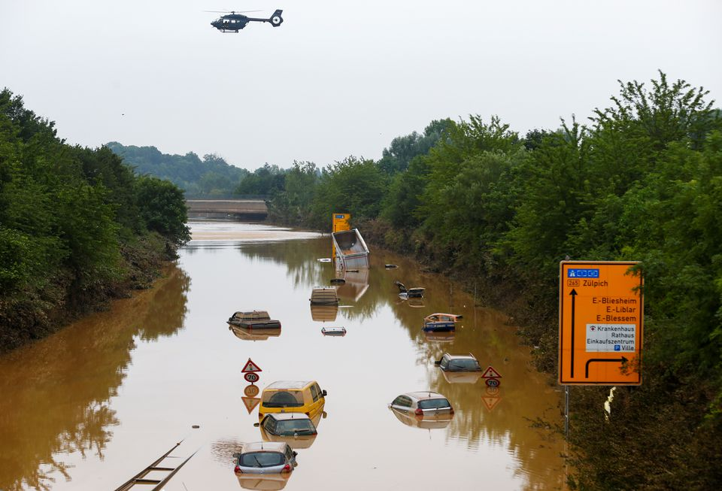
It is coming for us…
Climate change is expected to make extreme rain events more common!
Heavy rainfalls in Erftstadt-Blessem, Germany, July 17, 2021.
Source: REUTERS/Thilo Schmuelgen

Slide 15
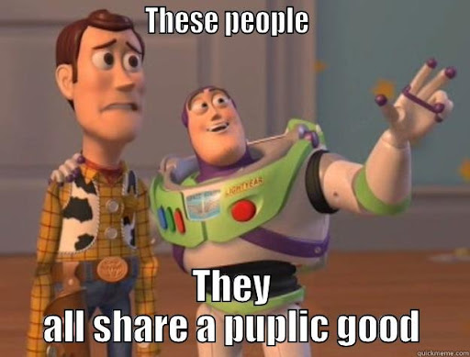
Climate is a public good!

Slide 16
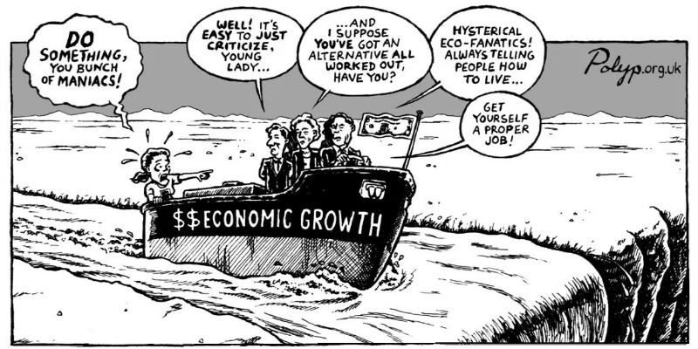
Economic growth in cost of climate?

Slide 17
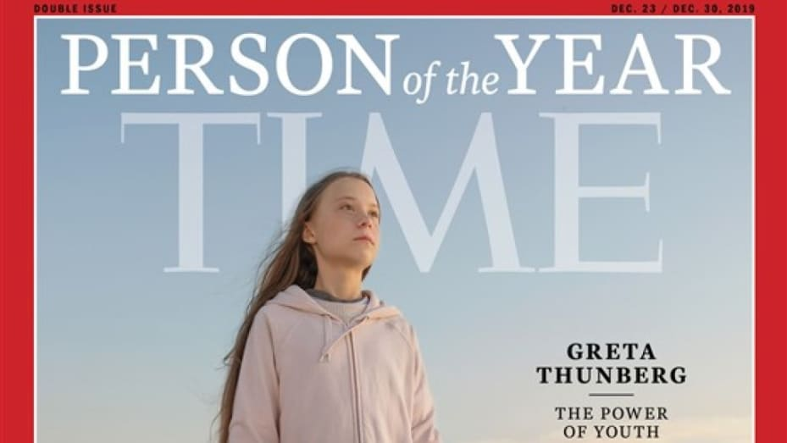
What is the solution?
“The climate crisis has already been solved. We already have all the facts and solutions. All we have to do is to wake up and change.”
Greta Thunberg

Slide 18
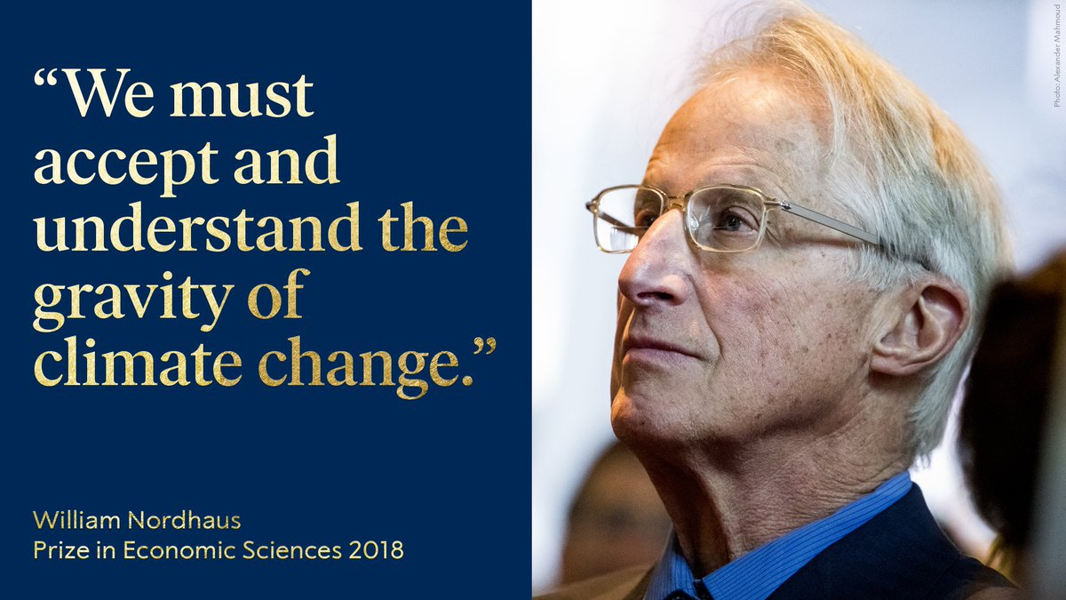

Slide 19
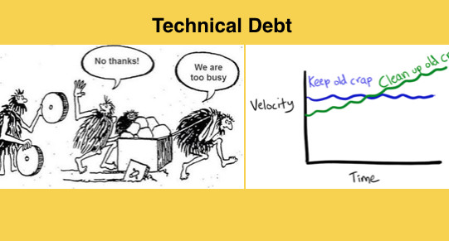
Not necessarily market distortion, but technical debt and bad political equilibrium!

Slide 20
Multi-level responsibilities regarding the bad equilibrium
International and regional institutions
Government
Social movements & parties
Individuals

Slide 21
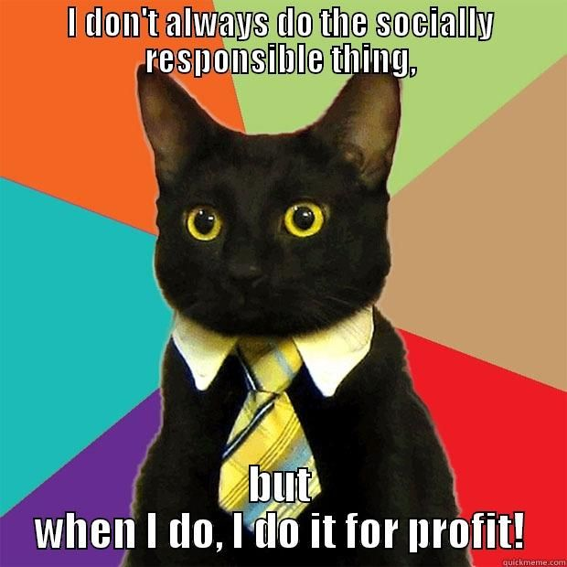
Leaving corporate out of the equation!
Firms’ objective is making profit, it has been always like this!
But the people’s economic and political decisions can influence on what products they can make money!

Slide 22
Personal Social Responsibility
“Personal Social Responsibility (PSR) is the primary responsibility of every individual toward family, workplace, community, and environment (both ecological and social).”
Our lifestyle decisions, vegetarian/biking/etc, have minimal effect on climate change!
Our lifestyle decisions, vegetarian/biking/etc, have minimal direct effect on climate change!
However, Our lifestyle decisions can have more significant indirect effects on climate change!

Slide 23
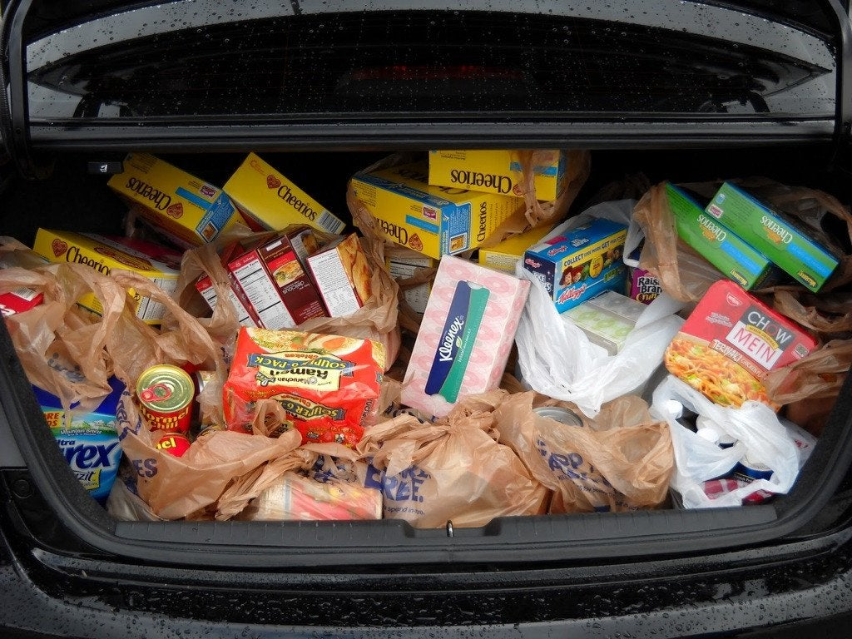
How we did grocery when we were in the US...

Slide 24
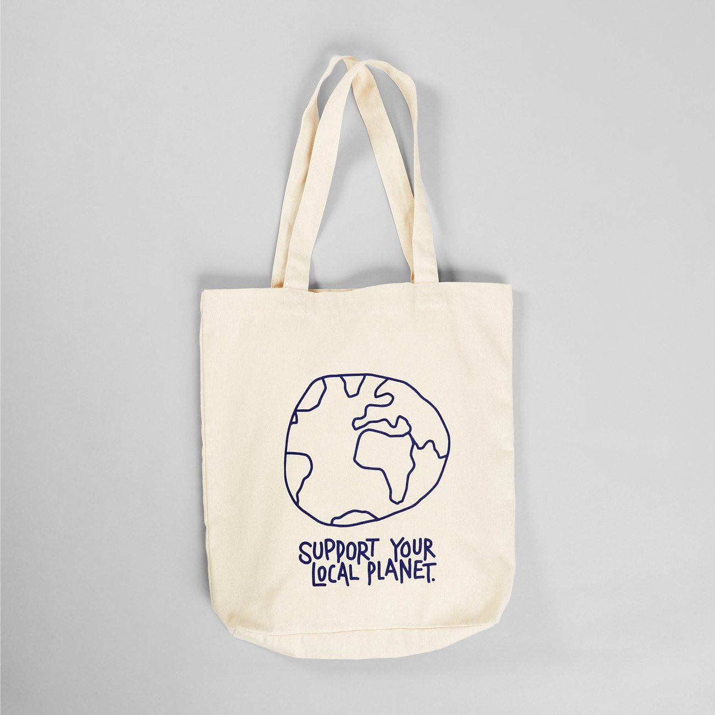
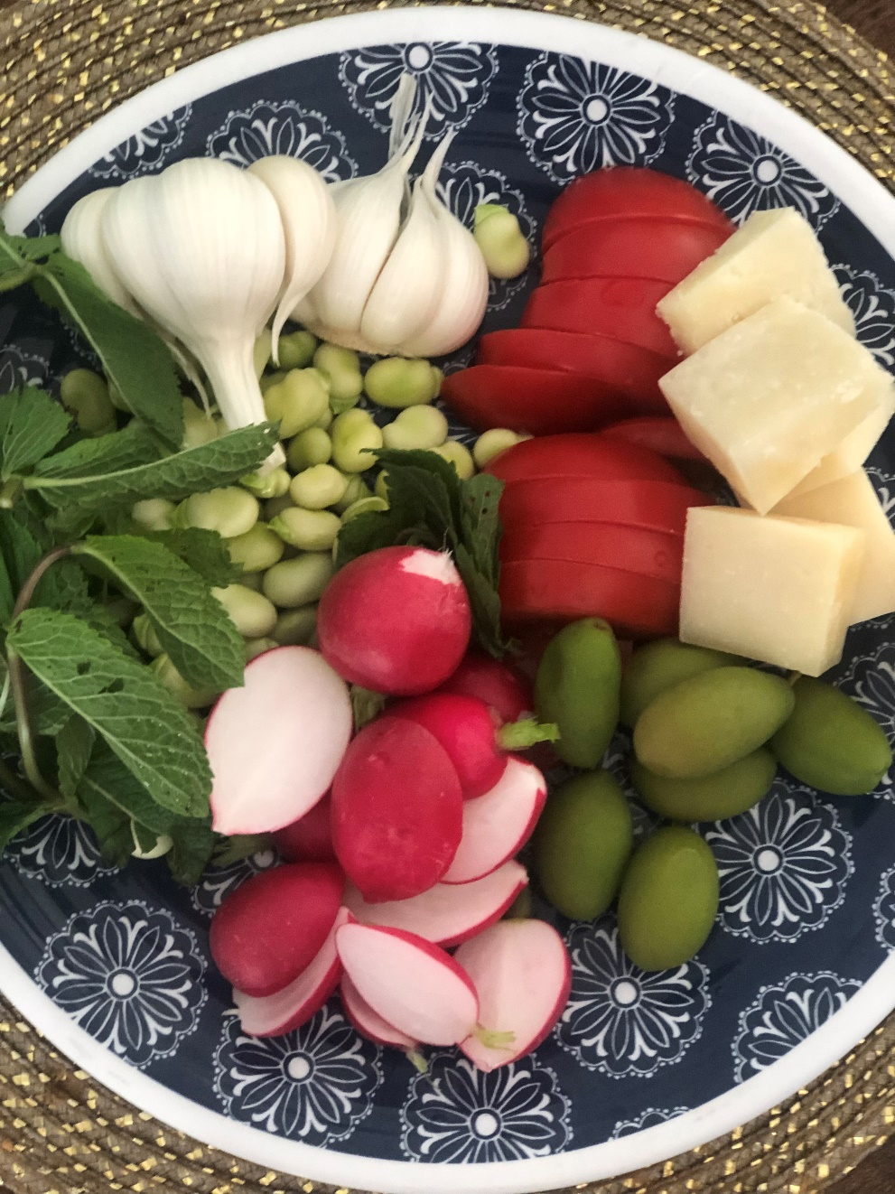
How we do grocery in the Netherlands

Slide 25
What did change?
There is a peer-effect.
Also, the society and government encourages this lifestyle.
Ex: The vegetarian options are not only cheaper, but also more delicious!
It is not only encouragement, but there are also policies in place…
Ex: Biking and public transportations, not only cheaper, but also faster and even more convenient…
Then, you have innovations and businesses facilitating your sustainable and environmentally friendly lifestyle.
These businesses might do it because of environment, but they do it mostly for its profit!
individual
friend/colleague network
Society/government
businesses

Slide 26
Last words...
Protesting and slacktivism is not enough! (In my opinion, has the least long-term effect!)
Be patient with climate-change deniers: don’t repress/downgrade them and let them freely express their opinions!
This allows debates and discussions; highlight the flaws; prevents echo chambers!
As a Social Scientist or Anthropologist, you should be able to explain to your friends, family, the society, why:
Climate change is real and caused by humans
Our individual level decision matters
Support collective efforts for change
Vote in elections for parties aligned with your environmentally-friendly agenda! Or, at least, vote out climate-change deniers!
We do not have much time but need to be reasonably patient, especially with individuals!
There are exciting academic studies on socio-political aspects of climate change:
Take classes on this topic
Maybe write your final thesis/project on it!

Slide 27
Thank you! Q&A? www.Babakrezaee.com Twitter: Babakrezaee

